Slide 1
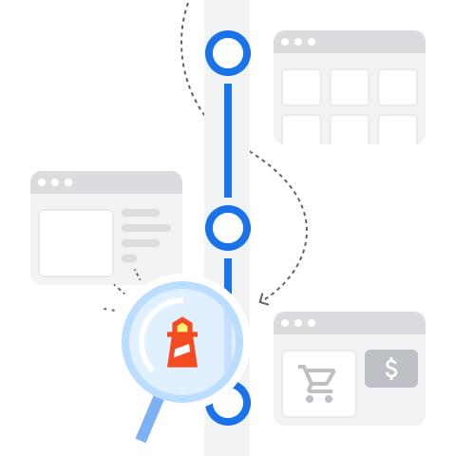
User Flows
Next level Runtime Performance Measures

Slide 2
Recorder
🎥
Record, replay, and measure user flows

Slide 3
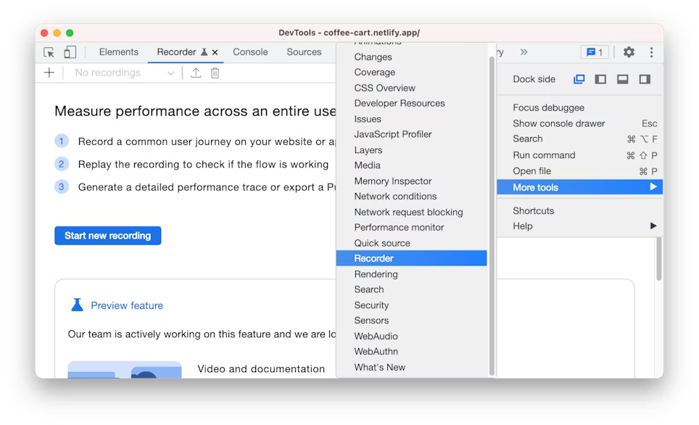

Slide 4
Start Recording
🎬

Slide 5
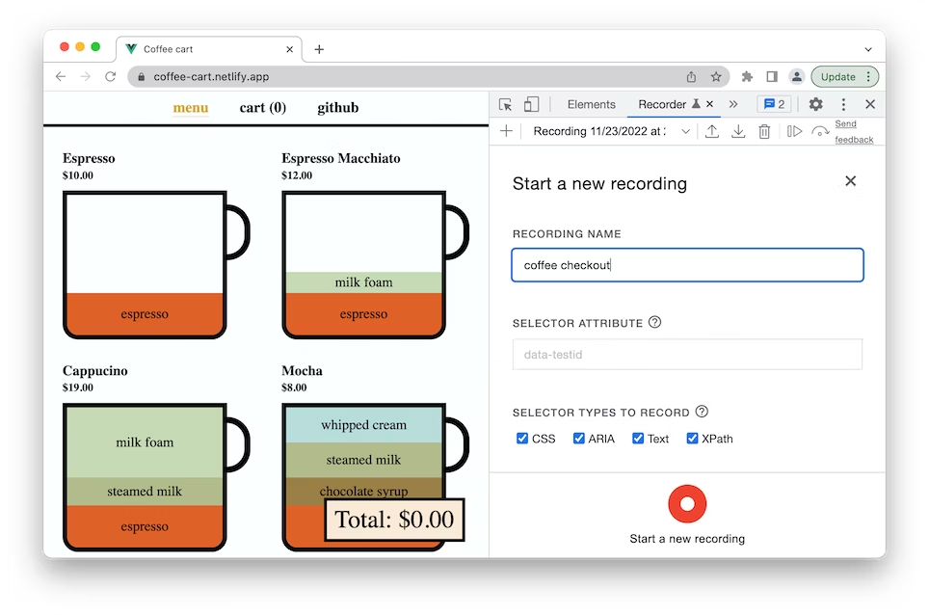

Slide 6
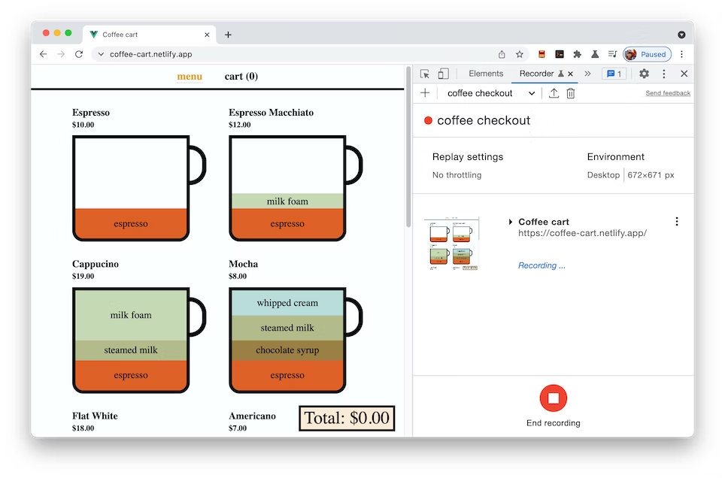

Slide 7
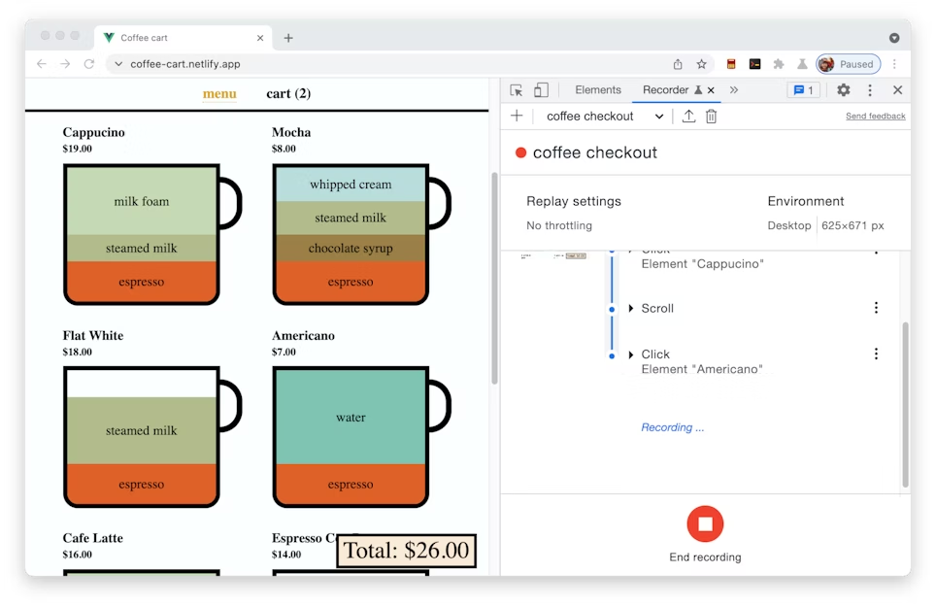
👆

Slide 8
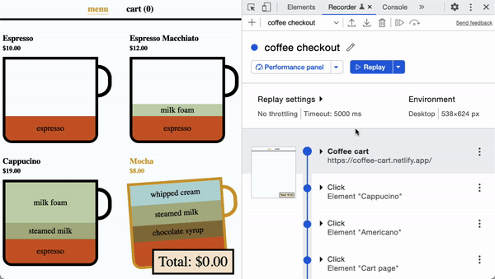

Slide 9
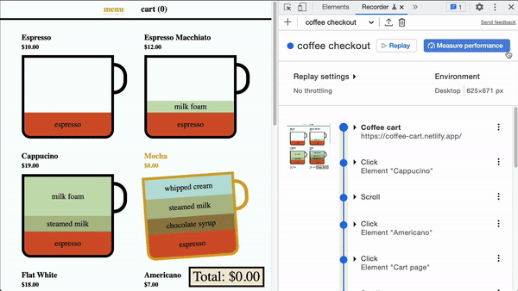

Slide 10
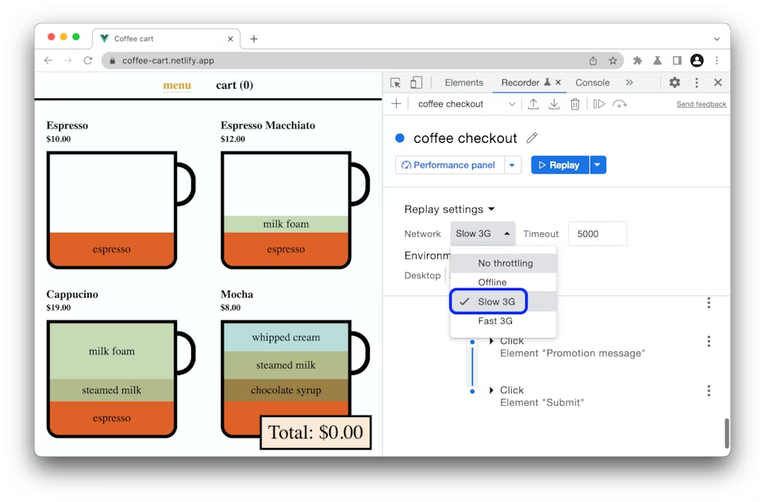

Slide 11
Edit Recording
✏️

Slide 12
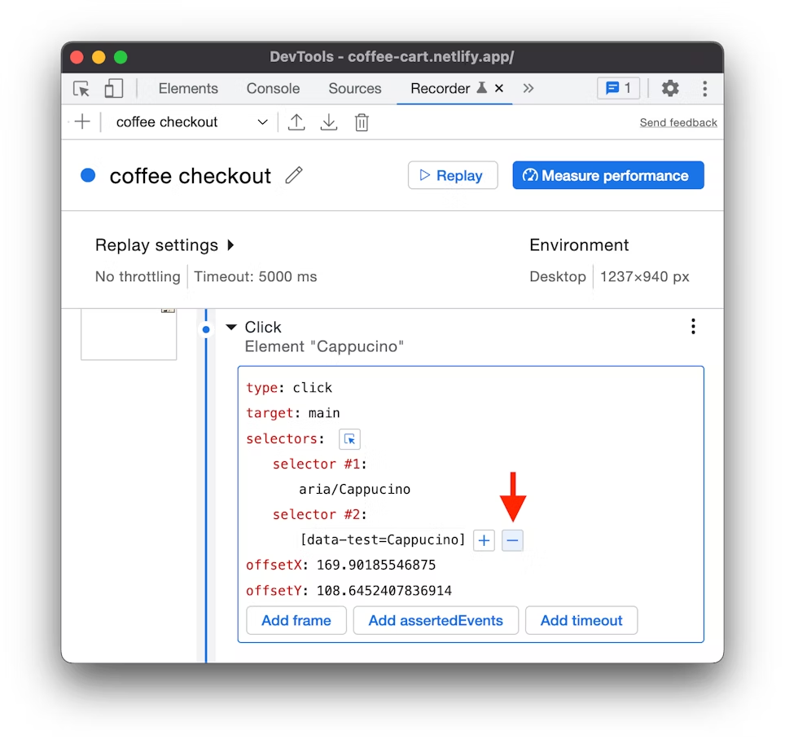
Add/Remove Selector

Slide 13
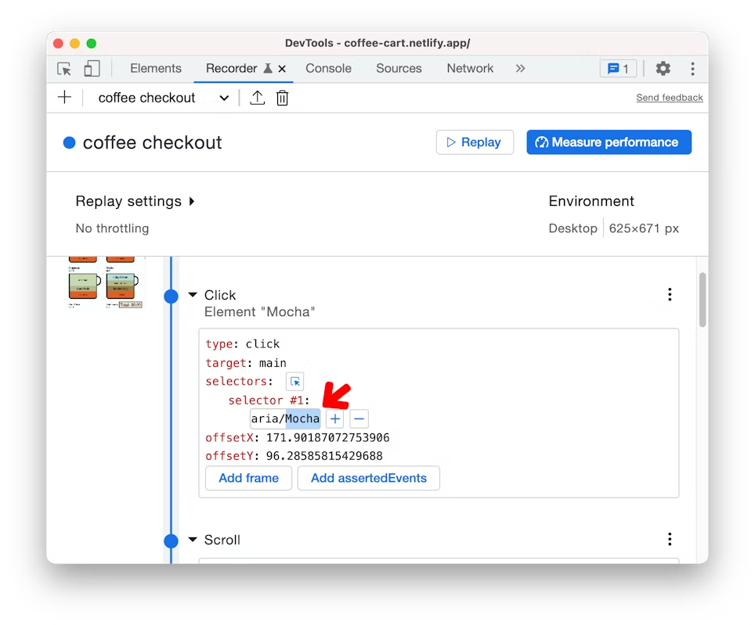
Edit Selector

Slide 14
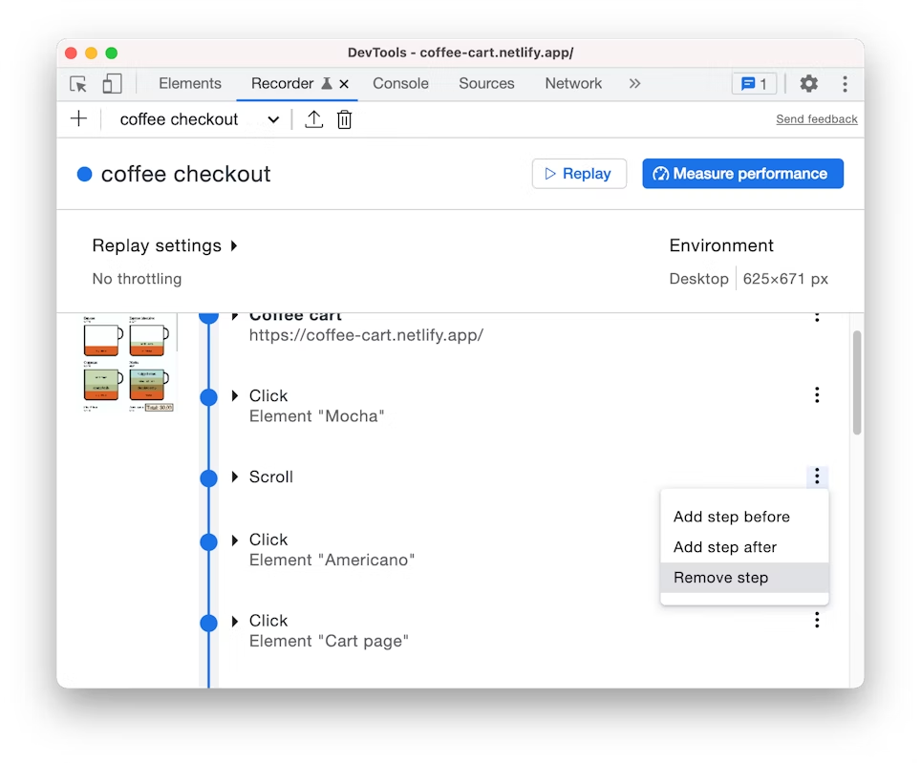
Add/Remove Step

Slide 15
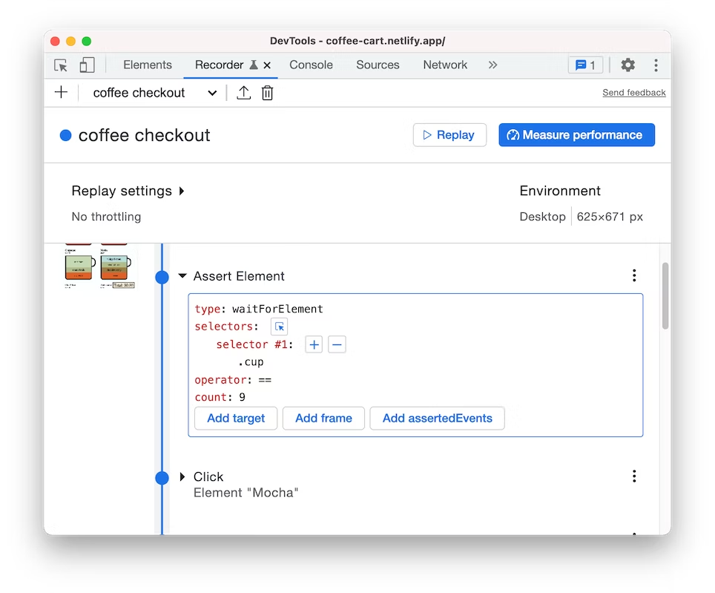
Advanced Element Assertion
wait until there are 9 .cup elements visible on the page

Slide 16
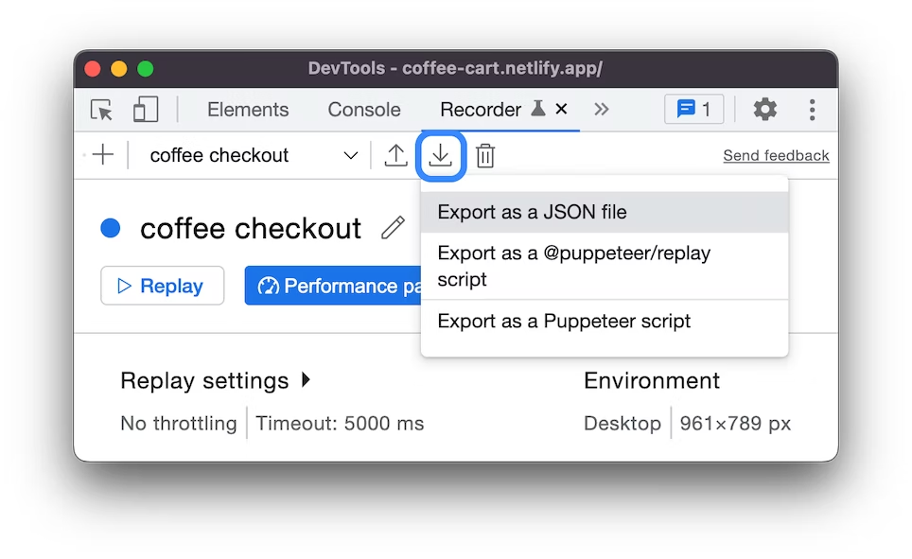
Export User Flows

Slide 17
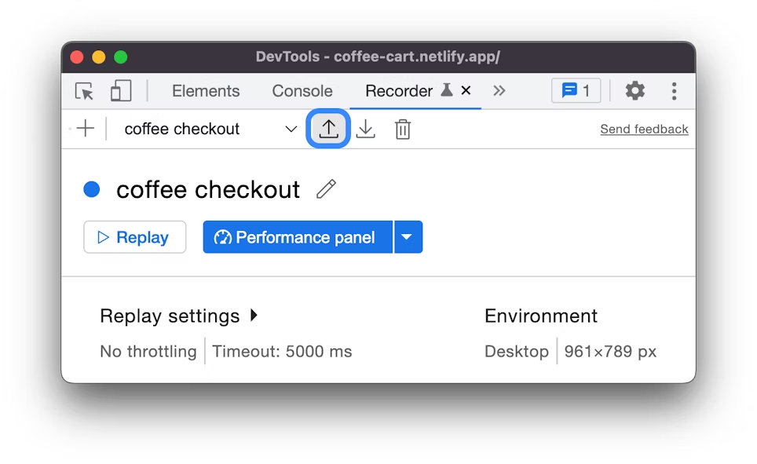
Export User Flows

Slide 18

Export User Flows
JSON
replay
script
human-readable JSON object useful to re-import into other recorders
replay script for @puppeteer/replay
steps remain as JSON
useful to integrate into CI/CD pipeline
converts recording to javascript code
run recording with puppeteer
cannot be converted back (no re-import possible)

Slide 19
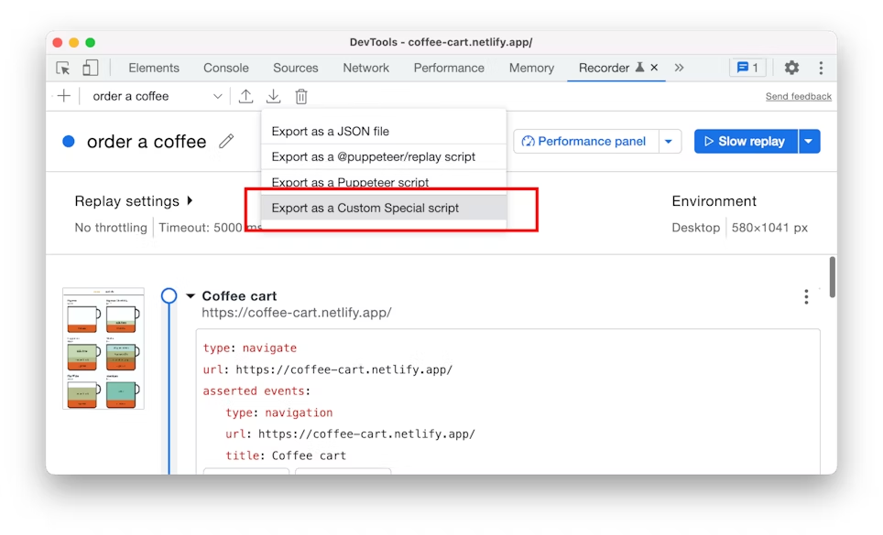
Export User Flows

Slide 20





Export User Flows
Notes:
Cypress extension lets you export JSON user flows as Cypress test script. Cypress is a front end testing tool built for the modern web.
WebPageTest extension lets you export user flows from the Recorder directly as WebPageTest Custom scripts to measure site's performance. See Converting user flows to WebPageTest custom scripts to learn more.
Nightwatch extension lets you export JSON user flows as Nightwatch test script. Nightwatch is an end-to-end testing solution for web applications and websites.
Testing Library extension lets you export JSON user flows as Testing Library script. Testing Library has simple and complete testing utilities that encourage good testing practices.
WebdriverIO extension lets you export JSON user flows as WebdriverIO test script. WebdriverIO is an end-to-end testing solution for web, mobile and IoT applications and websites.

Slide 21

Demo & Exercise Time!
Chrome User Flow Recorder

Slide 22

Lighthouse
Audit Web Vitals & Performance Best Practices

Slide 23
Lighthouse
Lighthouse analyzes web apps and web pages, collecting modern performance metrics and insights on developer best practices. GoogleChrome
Run:
in Chrome DevTools
from the command line (lighthouse CLI)
as nodejs script
from web UI
in CI (lighthouse CI)

Slide 24
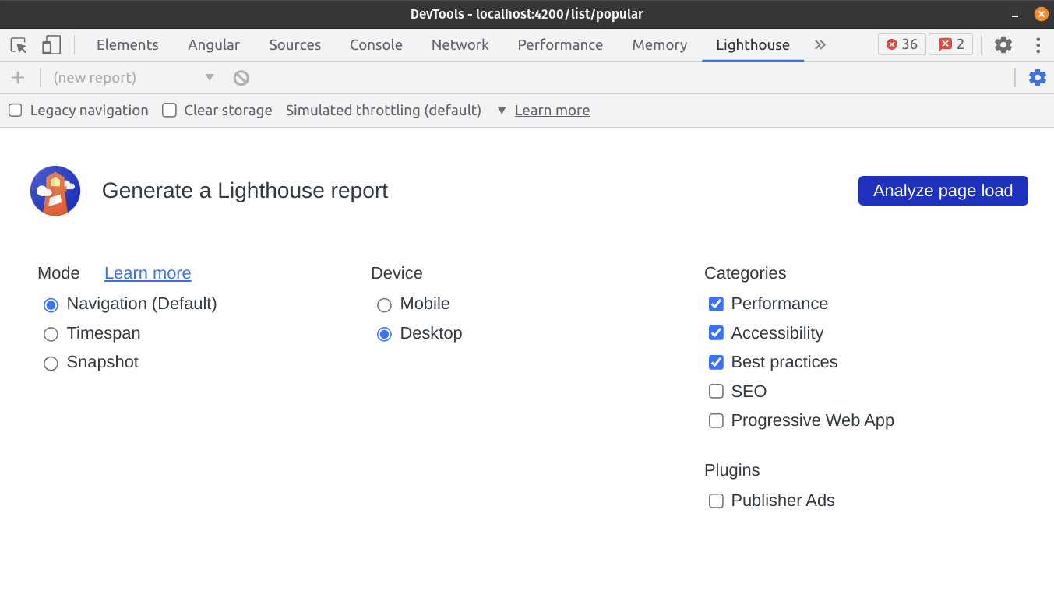

Slide 25
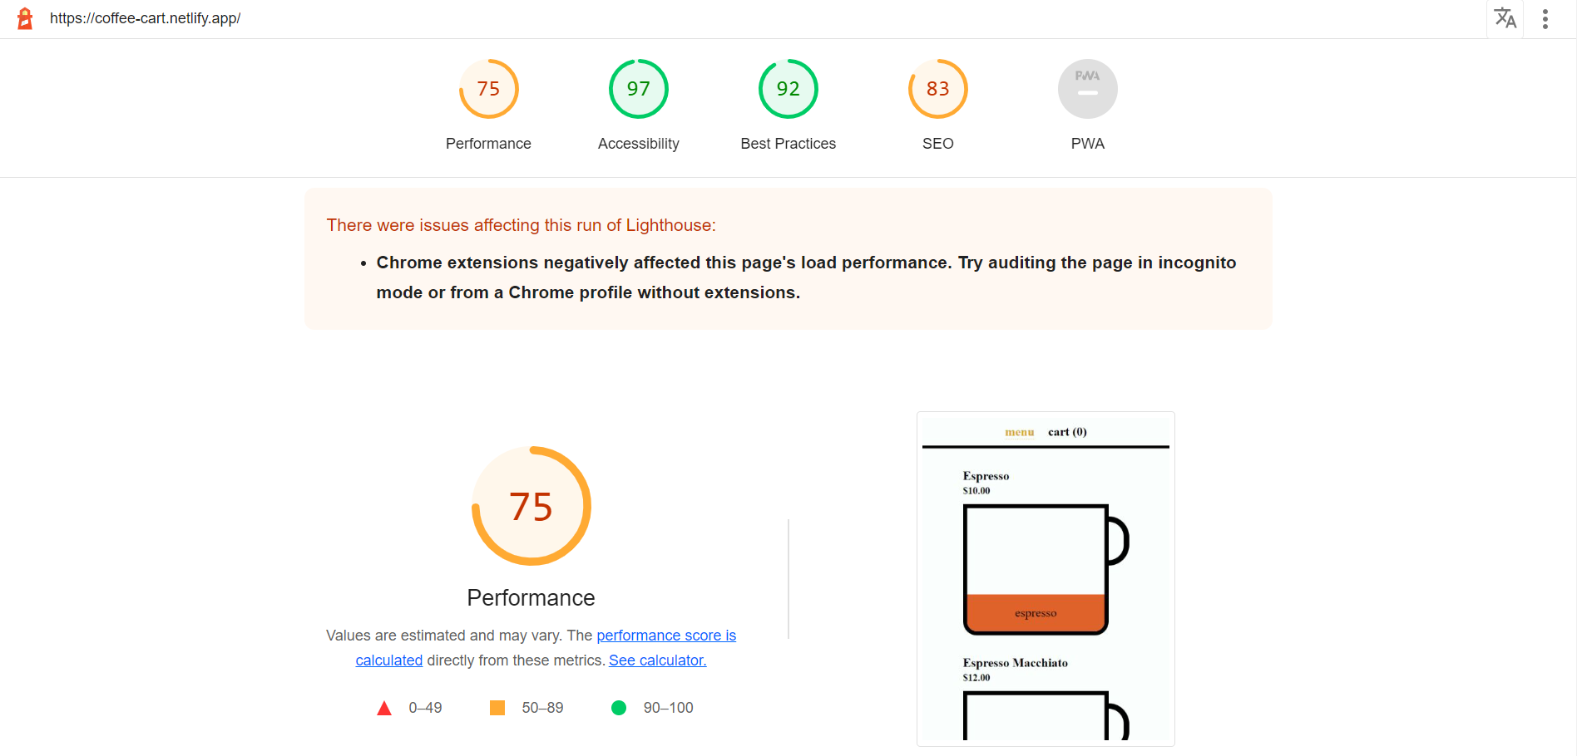

Slide 26
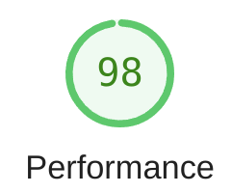
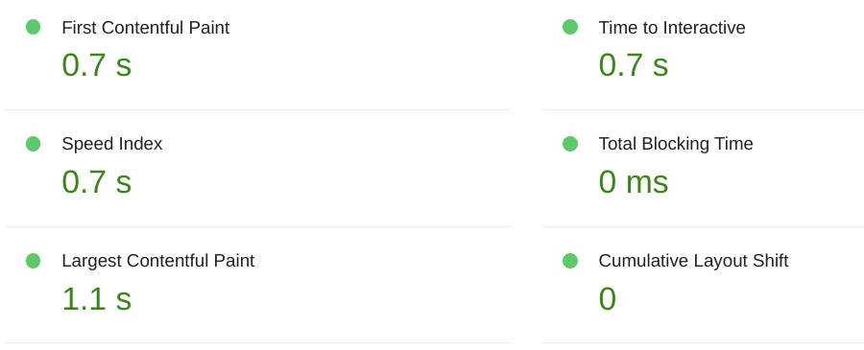

Slide 27

Bootstrap Performance Only
😞
navigation
🙄
🙄
🙄
🙄
🙄
🙄

Slide 28
User Flows
Audit the entire pages lifecycle

Slide 29


User Interactions Over Time
navigation
timespan
timespan
snapshot

Slide 30
💡 2 new modes!!

Slide 31
Measurement Modes - Overview
Icon | Mode | Measure | Performance | Accessibility | Best Practices | SEO | PWA
 | Navigation | Page load | 100% / 30 | 100% / 30 | 100% / 30 | 100% / 30 | ✔ / 7
 | Timespan | User Interaction | 10 / 10 | ❌ | 7 / 7 | ❌ | ❌
 | Snapshot | Current page state | 4 / 4 | 16 / 16 | 5 / 5 | 9 / 9 | ❌

Slide 32
Navigation
Timespan
Snapshot
✔️ Use Cases | 🤔 Limitations
lighthouse score with all metrics PWA accessibility | interactions (form submission, spa navigation) lazy-loaded, deferred contents
✔️ Use Cases | 🤔 Limitations
layout shifts js execution user experience over time | no overall score moment-based metrics (LCP, ..) accessibility PWA
✔️ Use Cases | 🤔 Limitations
analyze current state accessibility state hidden behind interaction | no overall score network, main-thread, js performance
Notes:
https://github.com/GoogleChrome/lighthouse/blob/03674e9b100f769367e4f174ba7ca29a5b081912/docs/user-flows.md

Slide 33
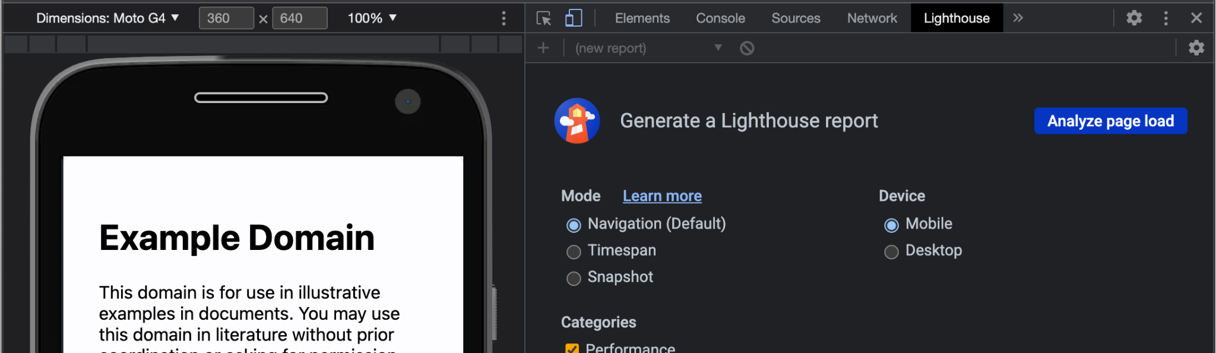
Navigation

Slide 34
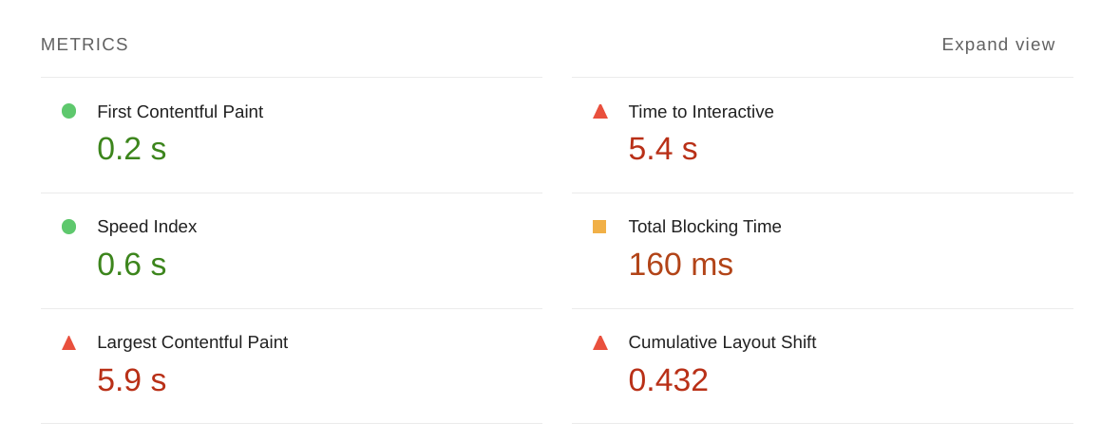
Navigation

Slide 35
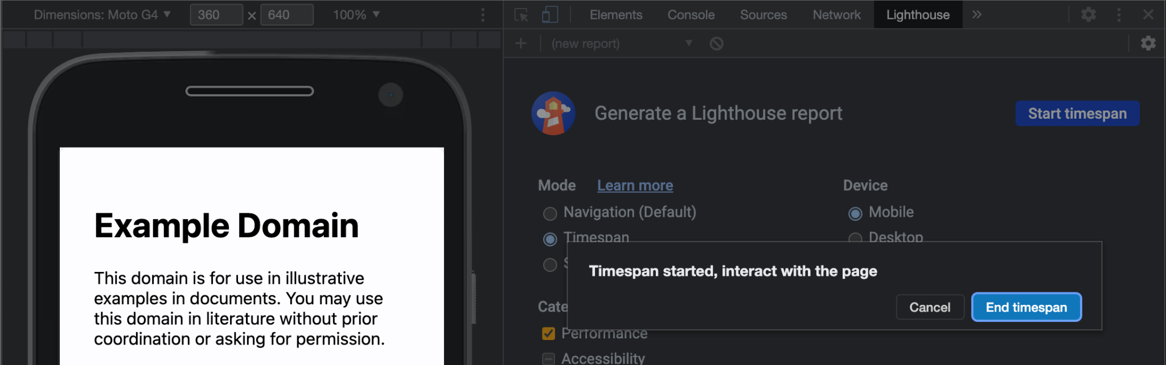
Timespan

Slide 36
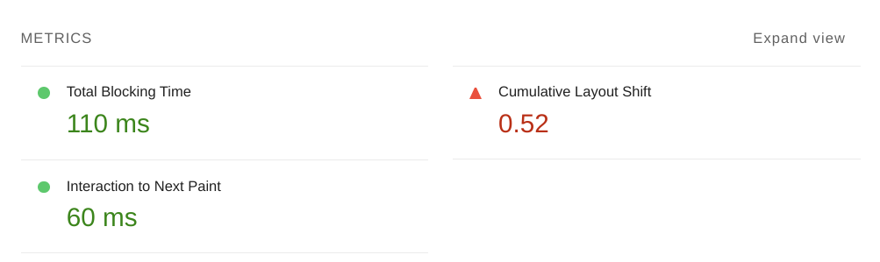
Timespan

Slide 37
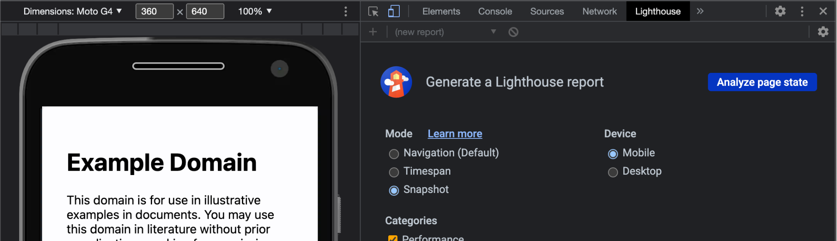
Snapshot

Slide 38
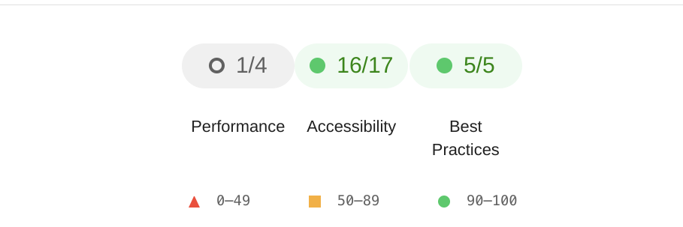
Snapshot

Slide 39
Demo & Exercise Time!
Lighthouse User Flows

Slide 40
The real power comes by combining all modes to a User Flow

Slide 41
Lighthouse CLI
npm i lighthouse -g
lighthouse https://youtube.com
docs
Notes:
https://github.com/GoogleChrome/lighthouse/tree/main/docs

Slide 42
Lighthouse CLI
use programmatically with nodejs
(async function() {
const browser = await puppeteer.launch();
const page = await browser.newPage();
const flow = await startFlow(page);
// custom code going here
await browser.close();
writeFileSync('report.html', await flow.generateReport());
})();

Slide 43
Navigation
// Navigate with a URL
await flow.navigate('https://example.com');
// Interaction-initiated navigation via a callback function
await flow.navigate(async () => {
await page.click('a.link');
});
Notes:
https://github.com/GoogleChrome/lighthouse/blob/main/docs/user-flows.md#triggering-a-navigation-via-user-interactions

Slide 44
Timespan
await flow.startTimespan();
await page.type('#password', 'L1ghth0useR0cks!');
await page.click('#login');
await page.waitForSelector('#dashboard');
await flow.endTimespan();

Slide 45
Snapshot
await page.click('#expand-sidebar');
await flow.snapshot();

Slide 46
User Interactions Over Time
navigation
timespan
timespan
snapshot

Slide 47
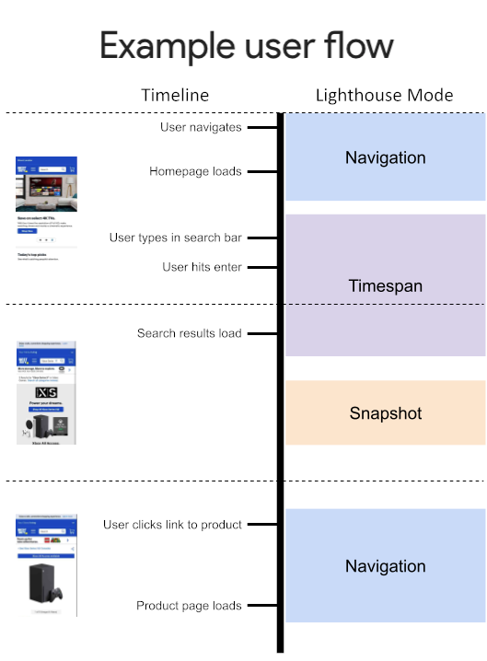
Notes:
https://github.com/GoogleChrome/lighthouse/blob/03674e9b100f769367e4f174ba7ca29a5b081912/docs/user-flows.md

Slide 48
Lighthouse CLI
Full User Flow
// Phase 1 - Navigate to the landing page.
await flow.navigate('https://www.bestbuy.com');
// Phase 2 - Interact with the page and submit the search form.
await flow.startTimespan();
await search(page);
await flow.endTimespan();
// Phase 3 - Analyze the new state.
await flow.snapshot();
// Phase 4 - Navigate to a detail page.
await flow.navigate(async () => {
const $document = await getDocument(page);
const $link = await queries.getByText($document, /Xbox Series X 1TB Console/);
$link.click();
});

Slide 49
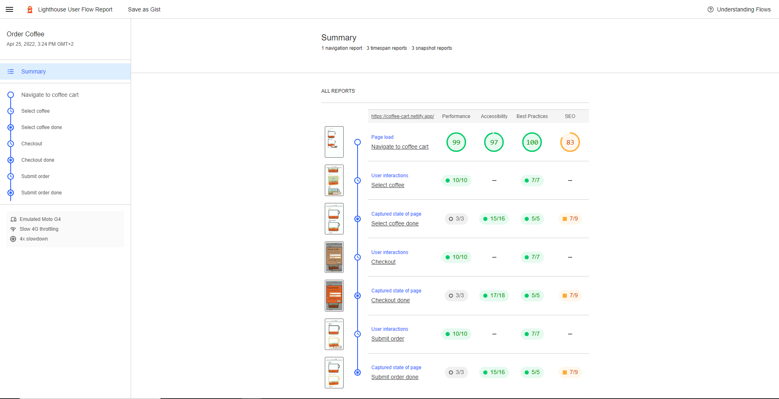

Slide 50
Performance budgets

Slide 51
Performance Budgets
lighthouse https://youtube.com --budget-path=budget.json
[
{
path: "/*",
resourceSizes: [
{
resourceType: "script",
budget: 200
}
]
}
]

Slide 52
Performance Budgets
Timing Budget
Resource Budget
size & count
first-contentful-paint
interactive
first-meaningful-paint
max-potential-fid
total-blocking-time
speed-index
largest-contentful-paint
cumulative-layout-shift
document
font
image
media
other
script
stylesheet
third-party
total

Slide 53
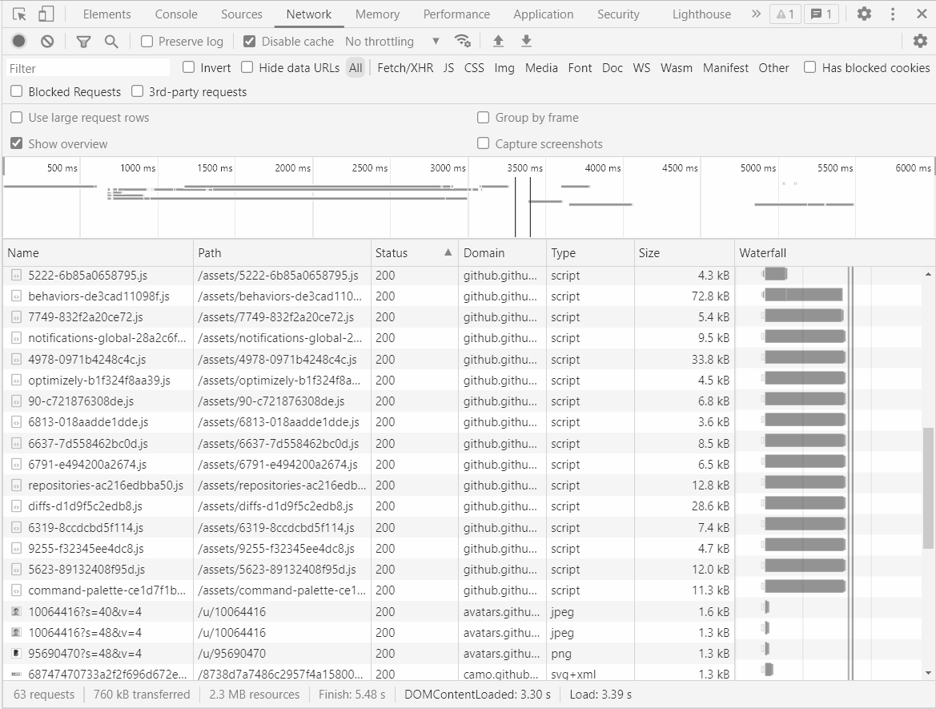
Performance Budgets in the Network Tab
{
path: path
options: {
firstPartyHostnames: [ name ]
},
resourceSizes: [
{ resourceType, number }
],
resourceCounts: [
{ resourceType, number }
]
}
github.com/push-based/user-flow/blob/main/packages/cli/README.md

Slide 54
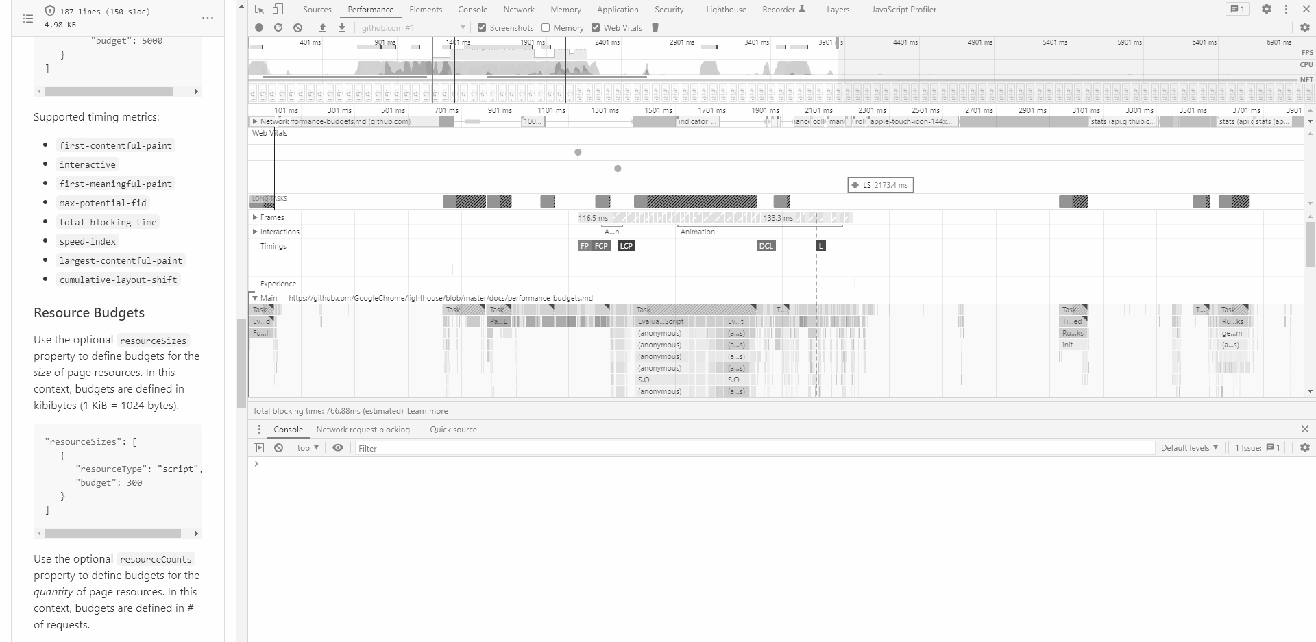
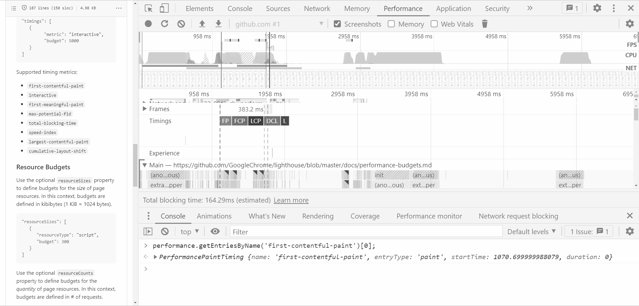
Performance Budgets in the Performance Tab
{
timing: [
{ 'cumulative-layout-shift', float }
{ 'first-contentful-paint', int },
{ 'first-meaningful-paint', int }, { 'largest-contentful-paint', int }, { 'interactive', int }, { 'max-potential-fid, int }, { 'total-blocking-time, int }, { 'speed-index', int }, }

Slide 55
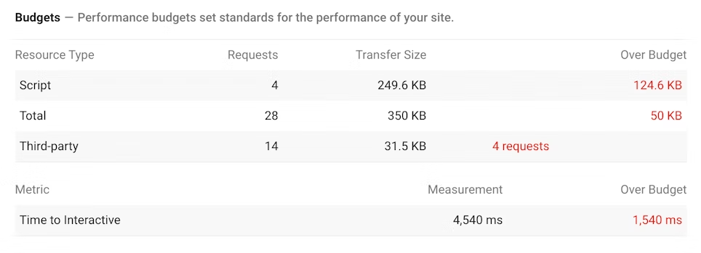
Performance Budgets

Slide 56



user-flow CLI
lighthouse user flows done right
🔗github.com/push-based/user-flow

Slide 57


user-flow CLI
first class typescript support
improved DX & applied best practices
🅾
0 boilerplate
🔗github.com/push-based/user-flow

Slide 58
Lighthouse CLI
(async function() {
const browser = await puppeteer.launch();
const page = await browser.newPage();
const flow = await startFlow(page);
// custom code going here
await browser.close();
writeFileSync('report.html', await flow.generateReport());
})();

Slide 59
user-flow CLI
const interactions: UserFlowInteractionsFn = async (
ctx: UserFlowContext
): Promise<unknown> => {
const { flow, collectOptions, page } = ctx;
// your code goes here
};

Slide 60
Use the Recorder Tool

Slide 61
user-flow CLI enrich & run flows from the recorder export
import { createUserFlowRunner } from '@push-based/user-flow';
await flow.startTimespan({ stepName: 'Checkout order' });
const runner =
await createUserFlowRunner('export.json', ctx)
await runner.run();
await flow.endTimespan();
⚙️

Slide 62
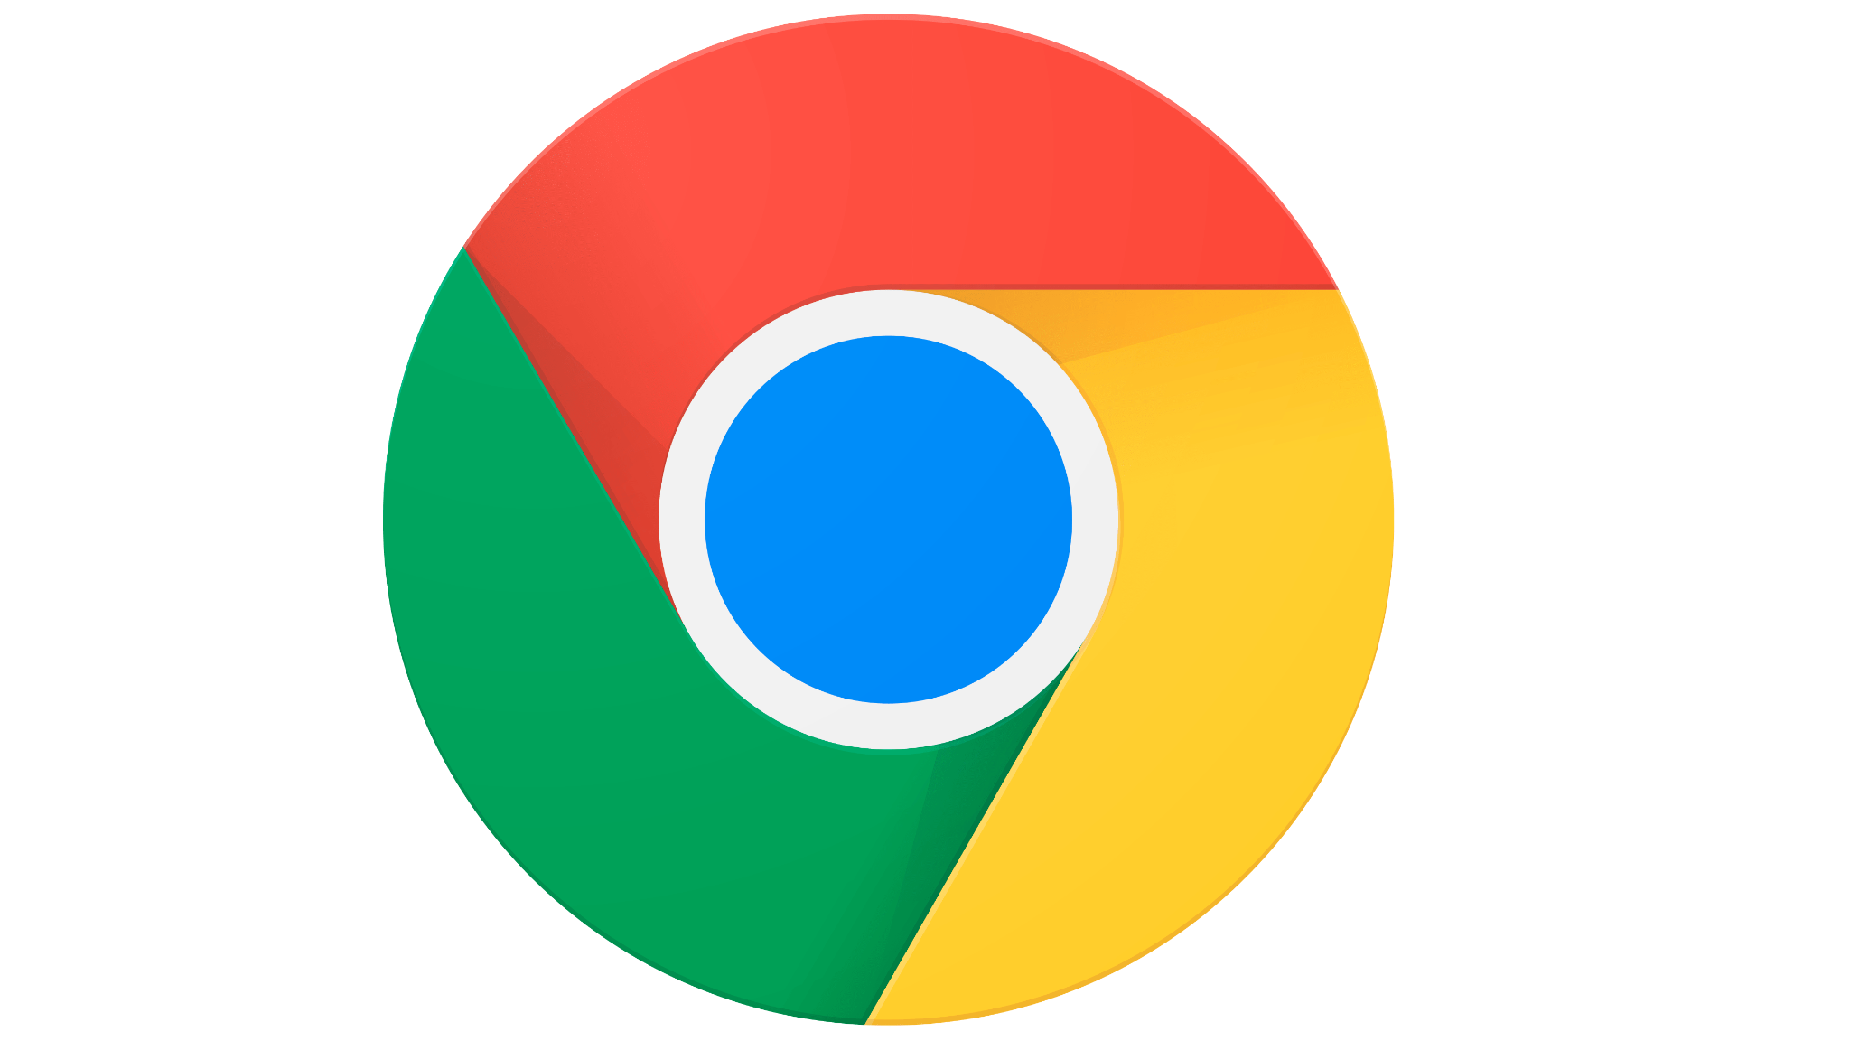
User Flow Objects UFO

Slide 63
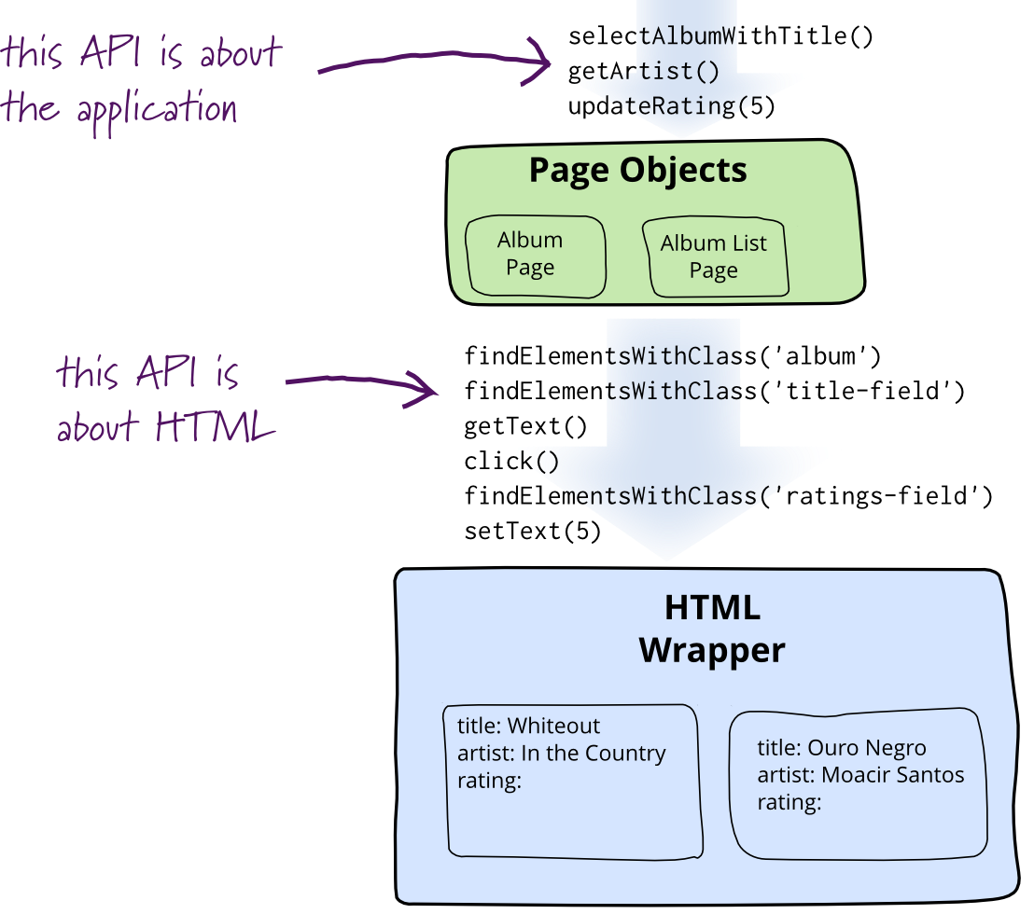
Martin Fowler

Slide 64
User Flow Objects
export class List extends Ufo {
itemSelector = fixtures.movieListImgSelector;
async clickItem(idx: number = 0) {
const item = this.itemSelector(idx);
await this.page.waitForSelector(item);
await this.page.click(item);
}
async awaitLCP() {
await this.page.waitForSelector(this.itemSelector(0));
}
}

Slide 65
User Flow Objects
await flow.startTimespan({
stepName: 'Navigate to list page',
});
// 👇 Interaction logic
await sidebar.awaitLCP();
await listPage.awaitLCP();
await flow.endTimespan();

Slide 66
Default
CLI
UFO’s
Import
Import
Import
Setup User Flow
Setup User Flow
Setup User Flow
Navigate
Navigate
Navigate
Await Ready
Await Ready
Await Ready
Start Timespan
Start Timespan
Start Timespan
Interactions
Interactions
Interactions
Stop Timespan
Stop Timespan
Stop Timespan
Await Ready
Await Ready
Await Ready
Snapshot
Snapshot
Snapshot

Slide 67
Demo & Exercise Time!
User Flow CLI

Slide 68
DRAFT FROM HERE

Slide 69
User Flow
Concept, Setup, Tooling

Slide 70


compose
develop
–dryRun –verbose …
🛸
🛸
🛸
__
__
__
__
measure & assert
persist
–budgets …
✔ __
❌__
✔ __
✔ __
✔ __
❌__
✔ __
✔ __
✔
✔

Slide 71
Performance budget

Slide 72
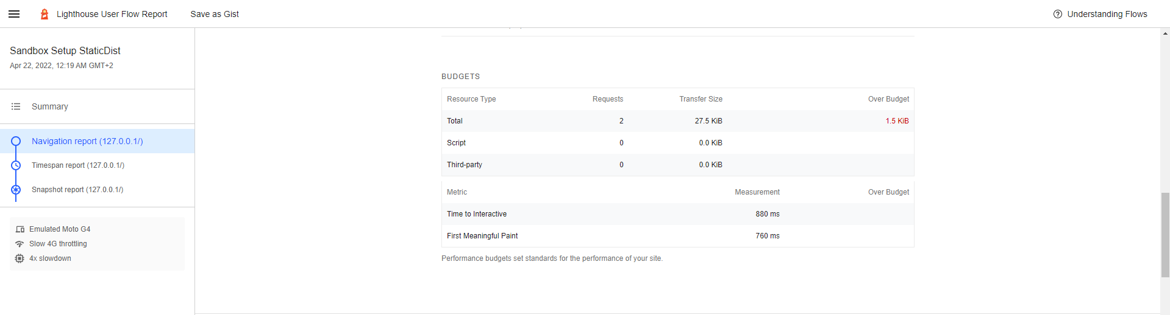
✔

Slide 73
github.com/push-based/user-flow/blob/main/packages/cli/README.md
{
path: path
options: {
firstPartyHostnames: [ name ]
},
resourceSizes: [
{ resourceType, number }
],
resourceCounts: [
{ resourceType, number }
]
}

Slide 74
{
timing: [
{ 'cumulative-layout-shift', float }
{ 'first-contentful-paint', int },
{ 'first-meaningful-paint', int }, { 'largest-contentful-paint', int }, { 'interactive', int }, { 'max-potential-fid, int }, { 'total-blocking-time, int }, { 'speed-index', int }, }

Slide 75
Performance
Accessibility
Best Practices
SEO
PWA
Performance
First Contentful Paint
Time To Interactive
Speed Index
Total Blocking Time

Slide 76
🔢
🎎
🅾
🔦
🛸
🛸
🛸
🆕
🗣

Slide 77
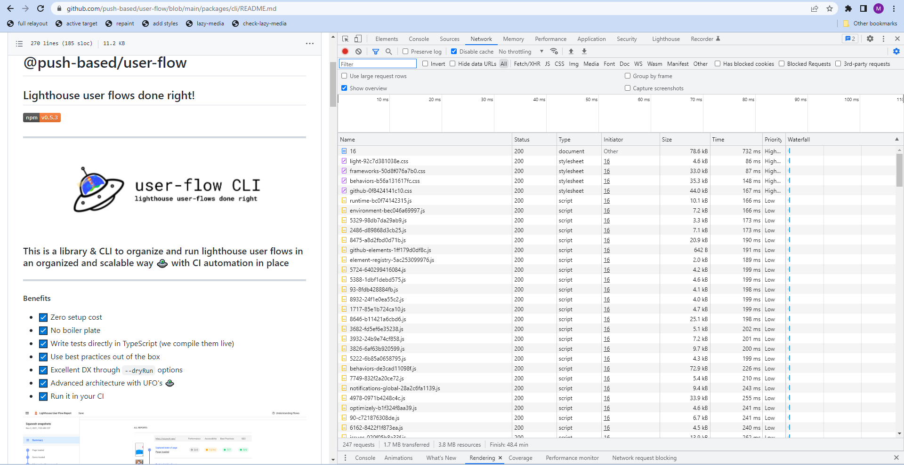
firstPartyHostnames
path
resourceType
resourceSizes
timings
resource
resourceCounts

Slide 78
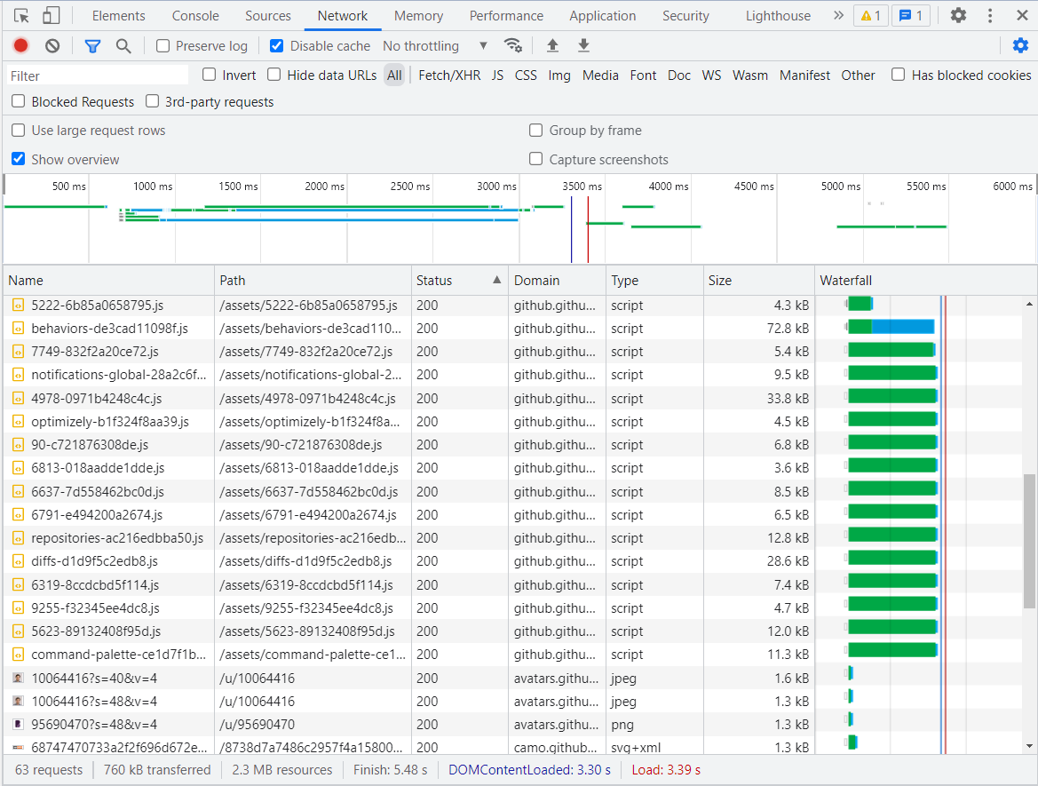
path
github.com/push-based/user-flow/blob/main/packages/cli/README.md

Slide 79



State Change
{ }
UI Interaction
UI Update
___
___
___
___
Browser Console
Background processes
🕑

Slide 80

script

Slide 81
user-flow CLI
lighthouse user flows automated

Slide 82
Setup
UF
User Flow Mode
UFO
Fixtures
Pupeteer
Interaction
Default
CLI
UFO’s
Import
Import
Import
Setup User Flow
Setup User Flow
Setup User Flow
Navigate
Navigate
Navigate
Await Ready
Await Ready
Await Ready
Start Timespan
Start Timespan
Start Timespan
Interactions
Interactions
Interactions
Stop Timespan
Stop Timespan
Stop Timespan
Await Ready
Await Ready
Await Ready
Snapshot
Snapshot
Snapshot

